Slide 1
Update Product Illustration

Slide 2
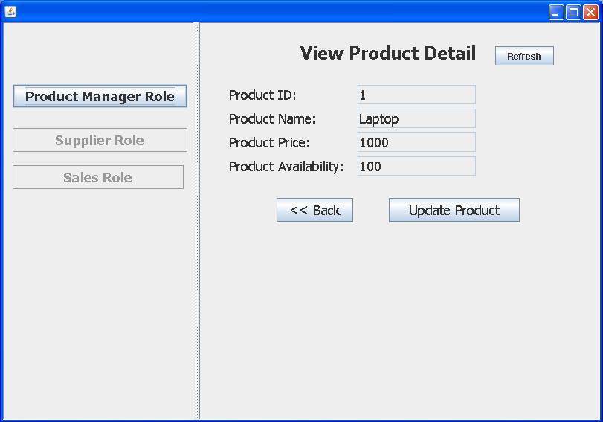
ViewProductDetailJPanel
These JTextFields
Cannot be edited
The product details on this page cannot be modified here.
In properties of JTextField.
Set Editable flag to “False” on each JTextField by removing a tick from “Editable” check box.

Slide 3
ViewProductDetailJPanel
Go to UpdateProductJPanel
Do not forget to pass product object to UpdateProductJPanel
UpdateProductJPanel jp = new UpdateProductJPanel(UserProcessContainerJPanel, product);

Slide 4
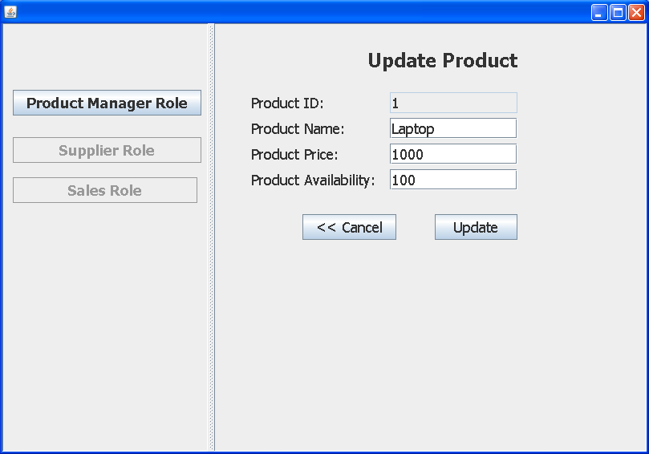
UpdateProductJPanel
idField.setText(product.getId());
etc.
1. In UpdateProductJPanel of based application, rename “Add” to “Update”
2. Display current product detail on JTextField. Note that product ID cannot be modified. (set Editable to False)

Slide 5
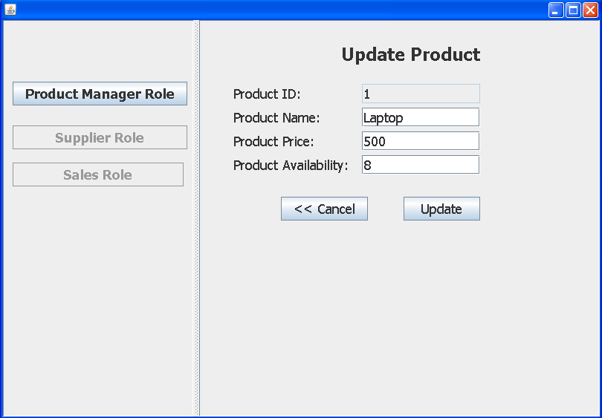
UpdateProductJPanel
Modify values
When you click update button, it should go
back to previous JPanel (ViewProductDetail)

Slide 6
ViewProductDetailJPanel
nameField.setText
(product.getName());
priceField.setText
(product.getPrice());
etc.
You will notice that the product information
does not get updated. Therefore, you need
“Refresh” button to update the product detail
on JTextFields.

Slide 7
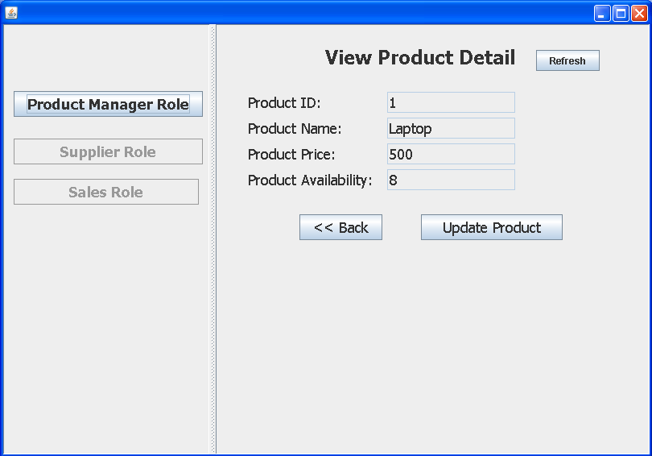
Done
After clicking on Refresh button, you
will see the updated product.

Slide 8
UpdateProductJPanel(Product)
Updated
Product
Product
id
id
id
name
name
name
price
price
price
avail
avail
Update
Put instructions here as to how the update to the product should be done.

